Slide 1
RDBMS Presentation
Relational database management system

Slide 2

Table of Contents
What is MySQL
What is PostgreSQL
What is SQL SERVER
comparison between this three RDBMS

Slide 3
What is MySQL ?
MySQL is an open source SQL relational database management system that’s developed and supported by Oracle.
That’s the short, one sentence answer to the question of “what is MySQL”, but let’s break that down into terms that are a little more human-friendly.
A database is just a structured collection of data that’s organized for easy use and retrieval. For a WordPress site, that “data” is stuff like the text of your blog posts, information for all the registered users at your site, autoloaded data, important settings configurations, etc.
MySQL is just one popular system that can store and manage that data for you, and it’s an especially popular database solution for WordPress sites.

Slide 4
What is PostgreSQL ?
PostgreSQL is a powerful, open source object-relational database system with over 30 years of active development that has earned it a strong reputation for reliability, feature robustness, and performance.
There is a wealth of information to be found describing how to install and use PostgreSQL through the official documentation. The PostgreSQL community provides many helpful places to become familiar with the technology, discover how it works, and find career opportunities.

Slide 5

What is SQL SERVER ?
SQL Server is a relational database management system, or RDBMS, developed and marketed by Microsoft.
Similar to other RDBMS software, SQL Server is built on top of SQL, a standard programming language for interacting with the relational databases. SQL server is tied to Transact-SQL, or T-SQL, the Microsoft’s implementation of SQL that adds a set of proprietary programming constructs.
SQL Server works exclusively on Windows environment for more than 20 years. In 2016, Microsoft made it available on Linux. SQL Server 2017 became generally available in October 2016 that ran on both Windows and Linux.

Slide 6
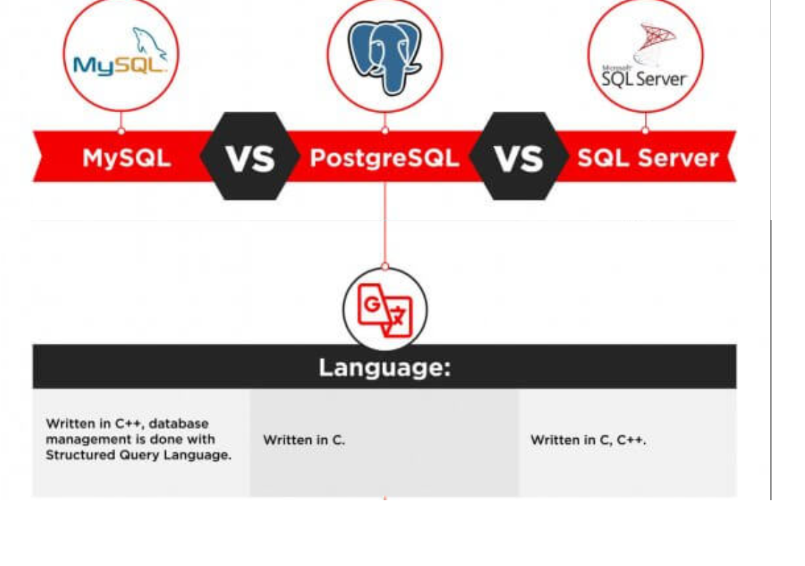
Comparison between this three RDBMS

Slide 7
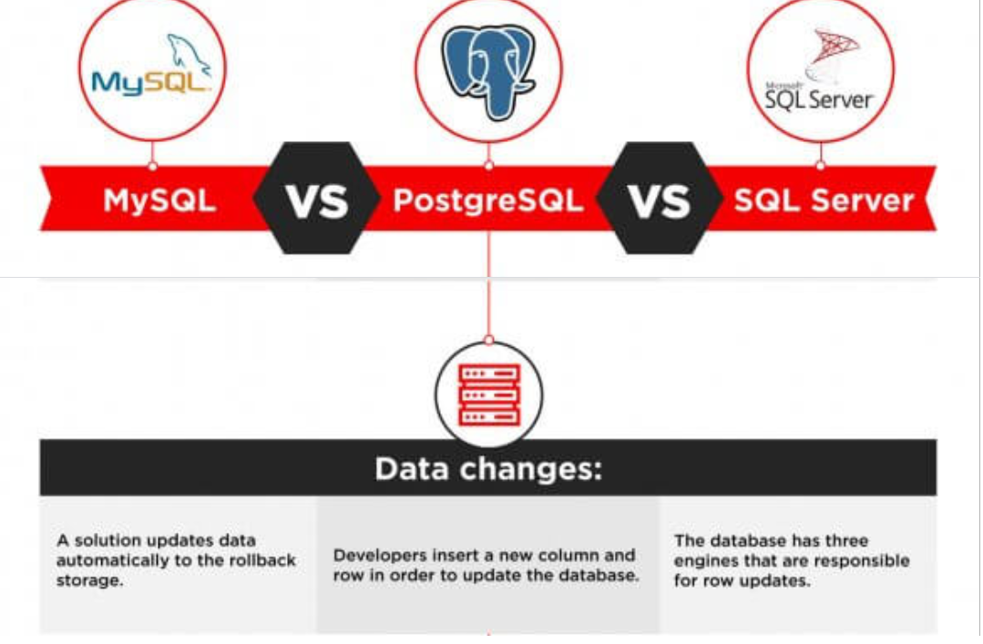
Comparison between this three RDBMS

Slide 8
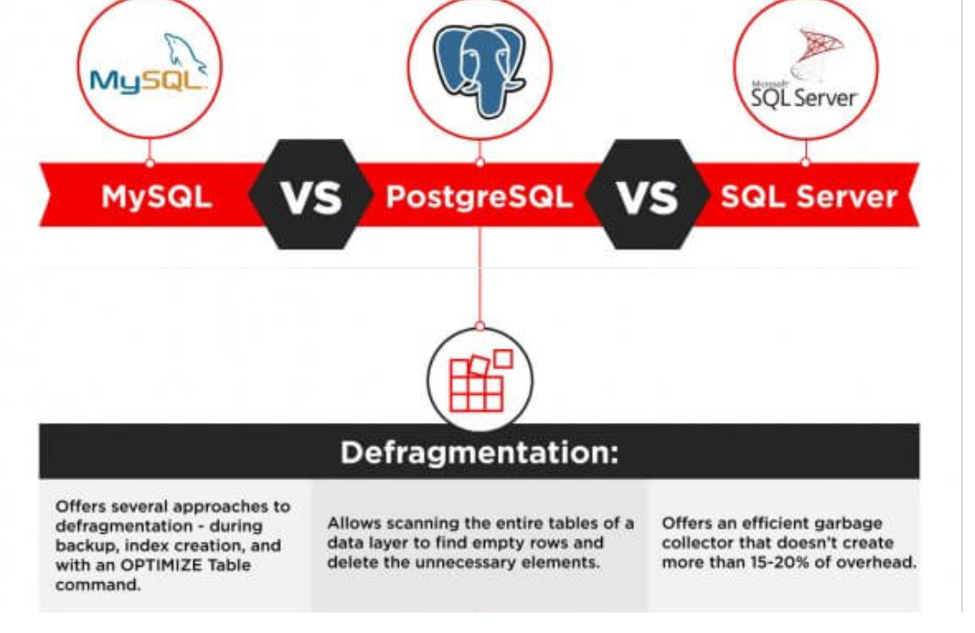
Comparison between this three RDBMS

Slide 9
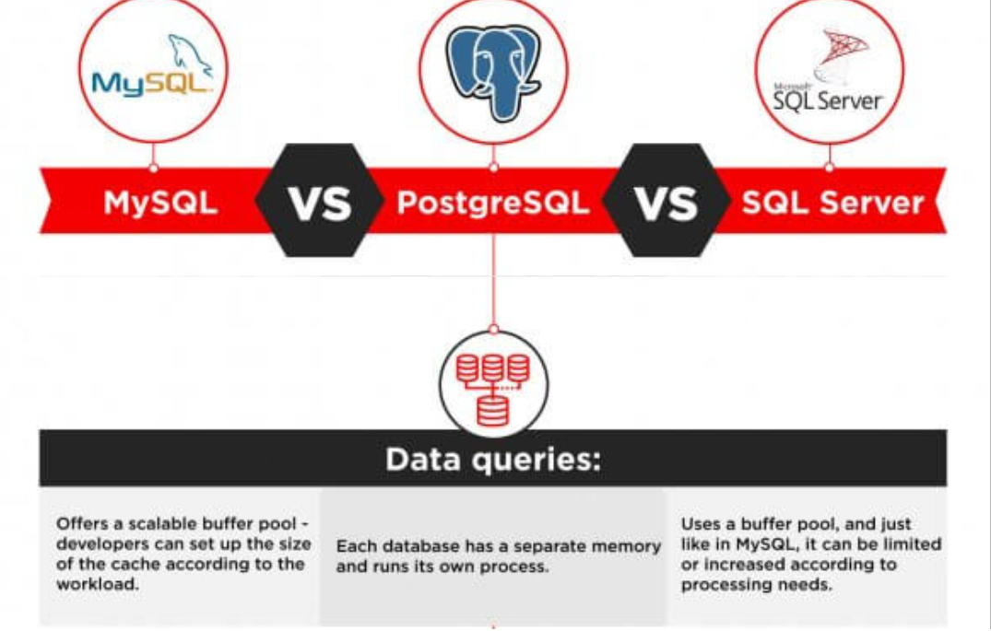
Comparison between this three RDBMS

Slide 10
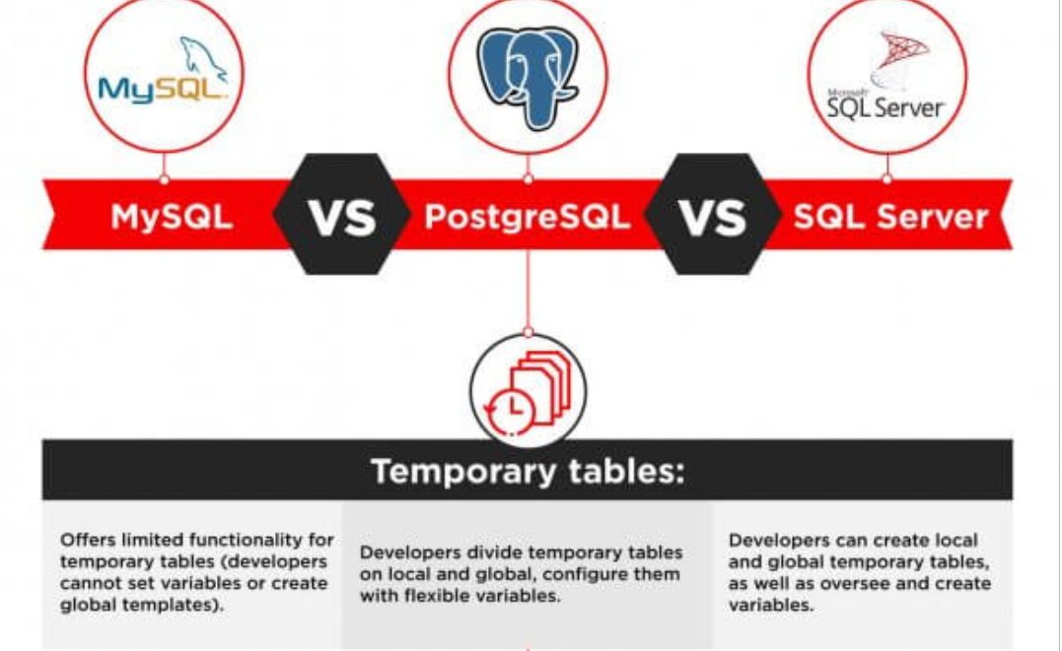
Comparison between this three RDBMS

Slide 11
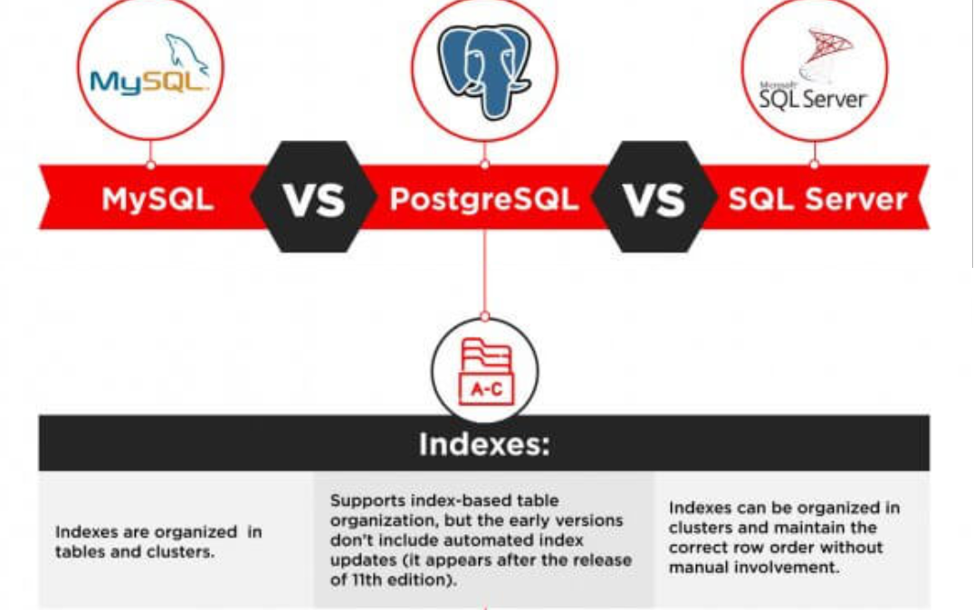
Comparison between this three RDBMS

Slide 12
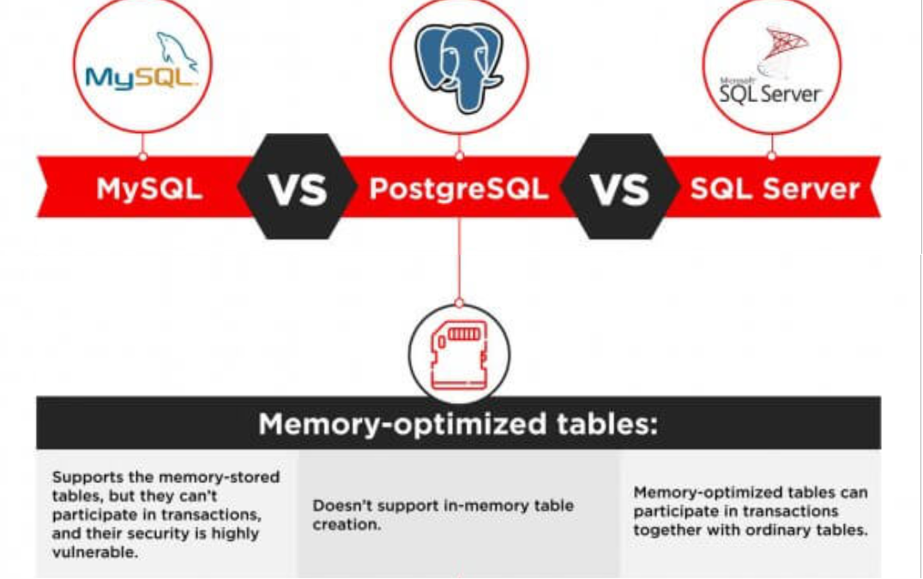
Comparison between this three RDBMS

Slide 13
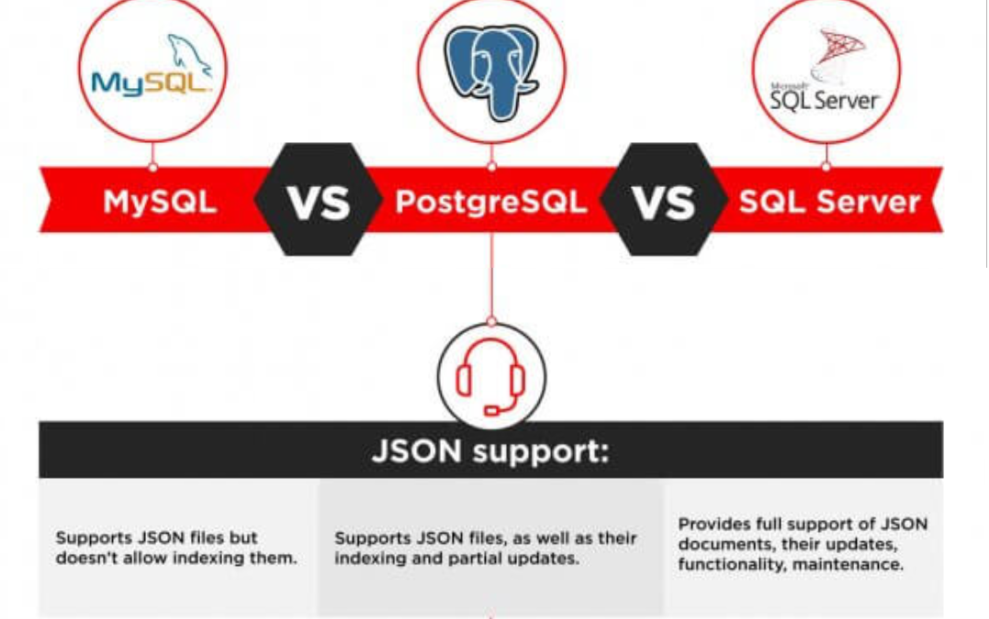
Comparison between this three RDBMS

Slide 14
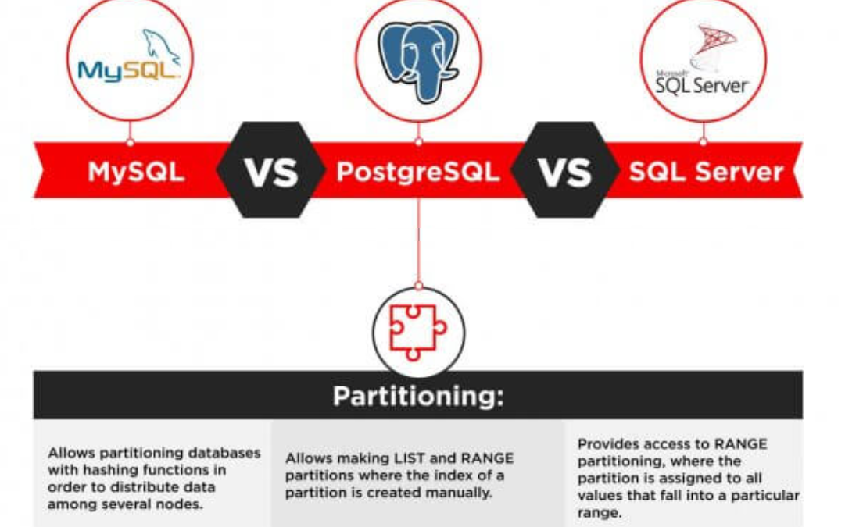
Comparison between this three RDBMS

